Slide 1

Targeted Adult Medicaid (TAM) Overview
August 2026

Slide 2

House Bill 437 of 2016 directed the Department of Health to expand coverage for three new eligibility groups of adults without dependent children
The 1115 Demonstration to expand coverage to these new groups was approved by the Centers for Medicare and Medicaid Services (CMS)
Effective date was November 1, 2017
6,500 adults are currently covered
TAM Overview

Slide 3
Group 1- Chronically Homeless
  A. Has a diagnosable substance use disorder, serious mental illness, developmental disability, post-traumatic stress disorder, cognitive impairments or chronic physical illness or disability, and who:
    Continuously homeless for at least 12 months or on at least four separate occasions in the last three years (totaling at least 12 months), OR
    Is living or residing in a place not meant for human habitation, a safe haven or in an emergency shelter for six months within a 12 month period, OR
    Currently living in supportive housing and previously met the definition of chronically homeless above.
  B. Is a victim of domestic violence who is residing in a place not meant for human habitation, a safe haven or in an emergency shelter.
TAM Groups

Slide 4
Group 2- Involved in the Justice System and Needing Substance Use or Mental Health Treatment
  Complied with and substantially completed a substance use disorder treatment program while incarcerated
  Is court ordered to receive substance abuse or mental health treatment through a district or tribal court
  Is currently involved in a drug or mental health court
  On probation or parole with a serious mental illness or substance use disorder
  Discharged from the Utah State Hospital after being admitted to the civil unit due to a criminal charge, or to the forensic unit due to a criminal offense
TAM Groups

Slide 5
Group 3- Individuals Needing Treatment
Receiving General Assistance from the Department of Workforce Services (DWS) and has a diagnosed substance use disorder or mental health disorder
Discharged from the Utah State Hospital after being civilly committed
TAM Groups

Slide 6
Open Enrollment
The approved 1115 Demonstration amendment gives the Department of Health and Human Services (DHHS) the ability to open and close enrollment in any of the waiver subcategories
Currently all subcategories in Eligibility Groups: 1 (Chronically Homeless), 2 (Justice Involved), and 3 (Individuals Needing Treatment) are open and will remain open until further notice
TAM Groups

Slide 7
Submit an application
Meet basic eligibility requirements, such as:
  residency
  citizenship/non-citizen
  SSN
  applying for other benefits
  between the ages of 19 and 64
No resource (assets) test
TAM Eligibility

Slide 8
No countable income after the 5% disregard
$66 per month for household size of 1
$89 per month for household size of 2 (individual + spouse)
No dependent children under the age of 19
Meet the criteria of one of the following groups:
  Chronically Homeless
  Justice Involved
  Individuals Needing Treatment
TAM Eligibility

Slide 9
Certification Period
12-month continuous eligibility, unless:
  Turns age 65,
  Moves out of state,
  Fails to apply for other benefits,
  Becomes institutionalized (suspension of benefits), or
  Is determined eligible for a higher priority Medicaid program.
TAM Eligibility

Slide 10
Hierarchy of Programs
Not eligible for TAM if eligible for other Medicaid programs (examples include):
  Parent Caretaker Relative
  Pregnant Woman
  Former Foster Care
If eligible for TAM, not eligible for:
  Adult Expansion
  Medically Needy (Spenddown)
  Refugee Medicaid
TAM Eligibility

Slide 11
Providers for Chronically Homeless
To be authorized to complete and sign the form 42A attesting to the eligibility of an individual in the Chronically Homeless population, the agency must:
  Have a tracking mechanism in place to be able to determine if they meet the Housing and Urban Development (HUD) definition of chronically homeless. The tracking mechanism must be in place and have been tracking the homeless individuals for at least one year, OR
  Have access to and be utilizing HUD’s HMIS system which contains the needed tracking data
Additionally, the agency must have first-hand knowledge of the applicant’s diagnosis of a substance use disorder, serious mental illness, developmental disorder, post-traumatic stress disorder, cognitive disorder or chronic physical illness or disability.
TAM Referral Forms

Slide 12
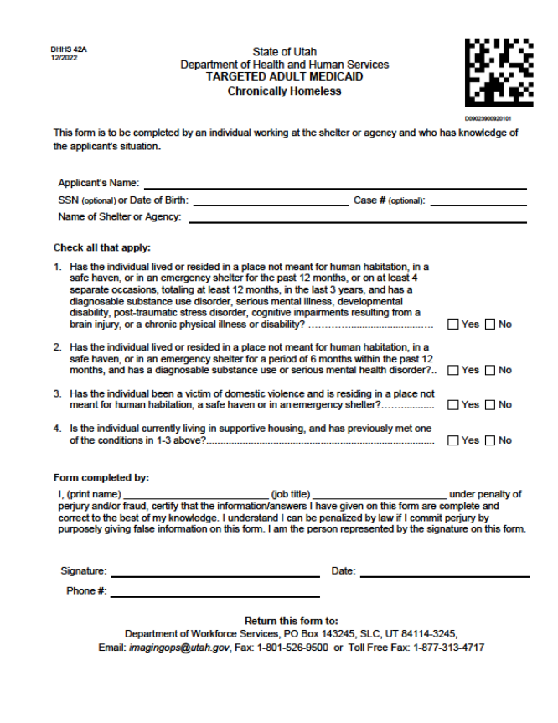
TAM Referral Forms

Slide 13
Justice Involved
To complete and sign the form 43A you must have first-hand information of the individual’s involvement with the correctional agency, court or agency working with the correctional agency; or be directly involved with the law enforcement agency, mental health court or drug court.
The individual must be ordered to receive substance use disorder or mental health treatment through a district or tribal court; or is on probation or parole and has a serious substance use disorder or serious mental illness.
TAM Referral Forms

Slide 14
The TAM form is to be completed and signed by an employee of the prison, jail, court or other approved private or government agency who has a knowledge of the applicant’s situation.
The form will be used to determine if the applicant meets the criteria of being ‘Justice Involved’ for the TAM program.
TAM Referral Forms

Slide 15
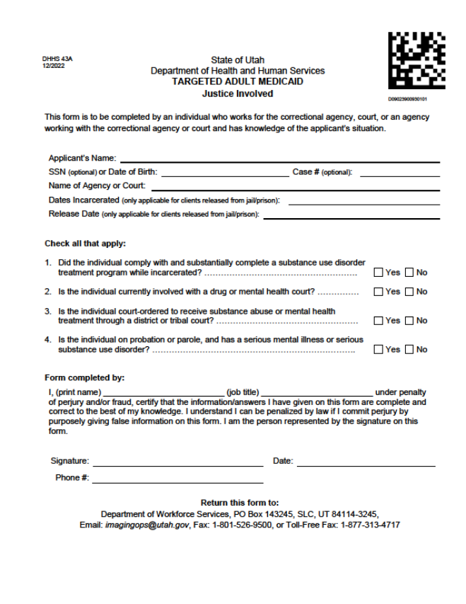
TAM Referral Forms

Slide 16
Individuals Needing Treatment State Hospital
The Form 44A is to be completed by an employee of the Utah State Hospital who has a knowledge of the applicant’s situation.
The form will be used to determine if the applicant meets the ‘State Hospital’ admission criteria for the TAM program.
TAM Referral Forms

Slide 17
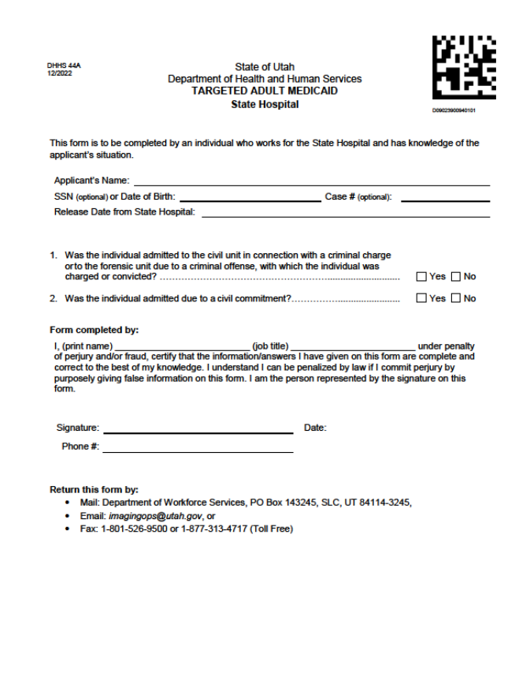
TAM Referral Forms

Slide 18
Individuals Needing Treatment General Assistance
Verify the substance use disorder or mental health disorder for the GA sub-group with a Form 1, 20, 20M or 45A.
The Form 45A should only be requested if the disorder cannot be verified using other means in the case record.
TAM Referral Forms

Slide 19
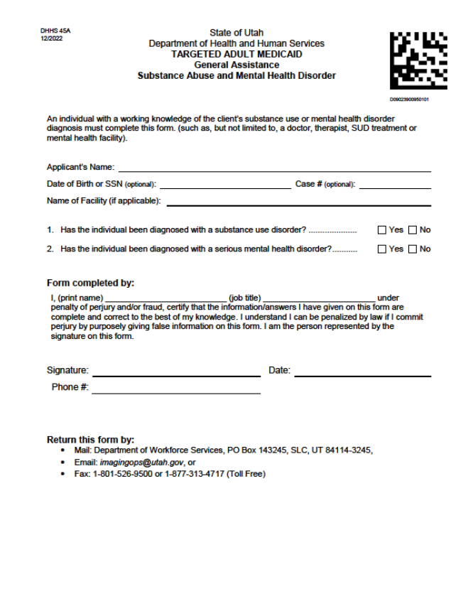
TAM Referral Forms

Slide 20
TAM documents can be sent in by email, fax, or mail.
  The preferred method is to send both the application/form (together) to imagingops@utah.gov which will ensure faster routing and processing.
  Mail: Imaging Operations, P.O. Box 143245, SLC, UT 84114-3245
  Fax: 877-313-4717
If an application is submitted in person, by mail, online, or fax, a worker will forward the documents to imaging, to ensure proper processing.
If an application is submitted (online or otherwise) without a referral form, a worker may not be able to identify the applicant as TAM eligible.
Applications and Referral Forms

Slide 21
A specialized group at DWS process all TAM applications
Calls will route the same as other Medicaid programs
Applications will follow the current processing timeframes
Specialized Workers

Slide 22
Contact Information
For questions regarding eligibility, TAM forms, training, or to become an approved agency and/or provider:
Jeff Dart
Department of Health and Human Services
jdart@utah.gov / (801) 538-6509

Slide 23
TAM members receive traditional benefits, including:
  Inpatient hospital
    Including LTAC and rehab for intensive skilled care
  Outpatient hospital
    Emergency hospital services
    Clinic services
  Laboratory and x-ray
  Skilled nursing facilities
  Women’s services including family planning (if a member becomes pregnant, they will be moved to the Pregnant Woman program)
  Physician services
  Substance use disorder and mental health services
TAM Benefits

Slide 24
  Medical care furnished by any licensed practitioner within the scope of their practice as defined by state law
      Podiatry
      Nurse midwife
      Nurse practitioners
    Home health
    Medical supplies, equipment, and appliances
    Physical and occupational therapy
    Prescribed drugs
    Prosthetic devices
    Diabetes Self-Management training
TAM Benefits

Slide 25
    Tobacco Cessation Services
    Intermediate care facilities for members with intellectual disabilities
    Hospice
    Medical transportation - both emergency and non-emergency
Dental benefits:
  Members 21 years of age and older may be eligible to receive dental services. All dental services will be provided by the University of Utah School of Dentistry (UUSOD) and its statewide provider network.
  All benefits will be paid fee for service
TAM Benefits

Slide 26
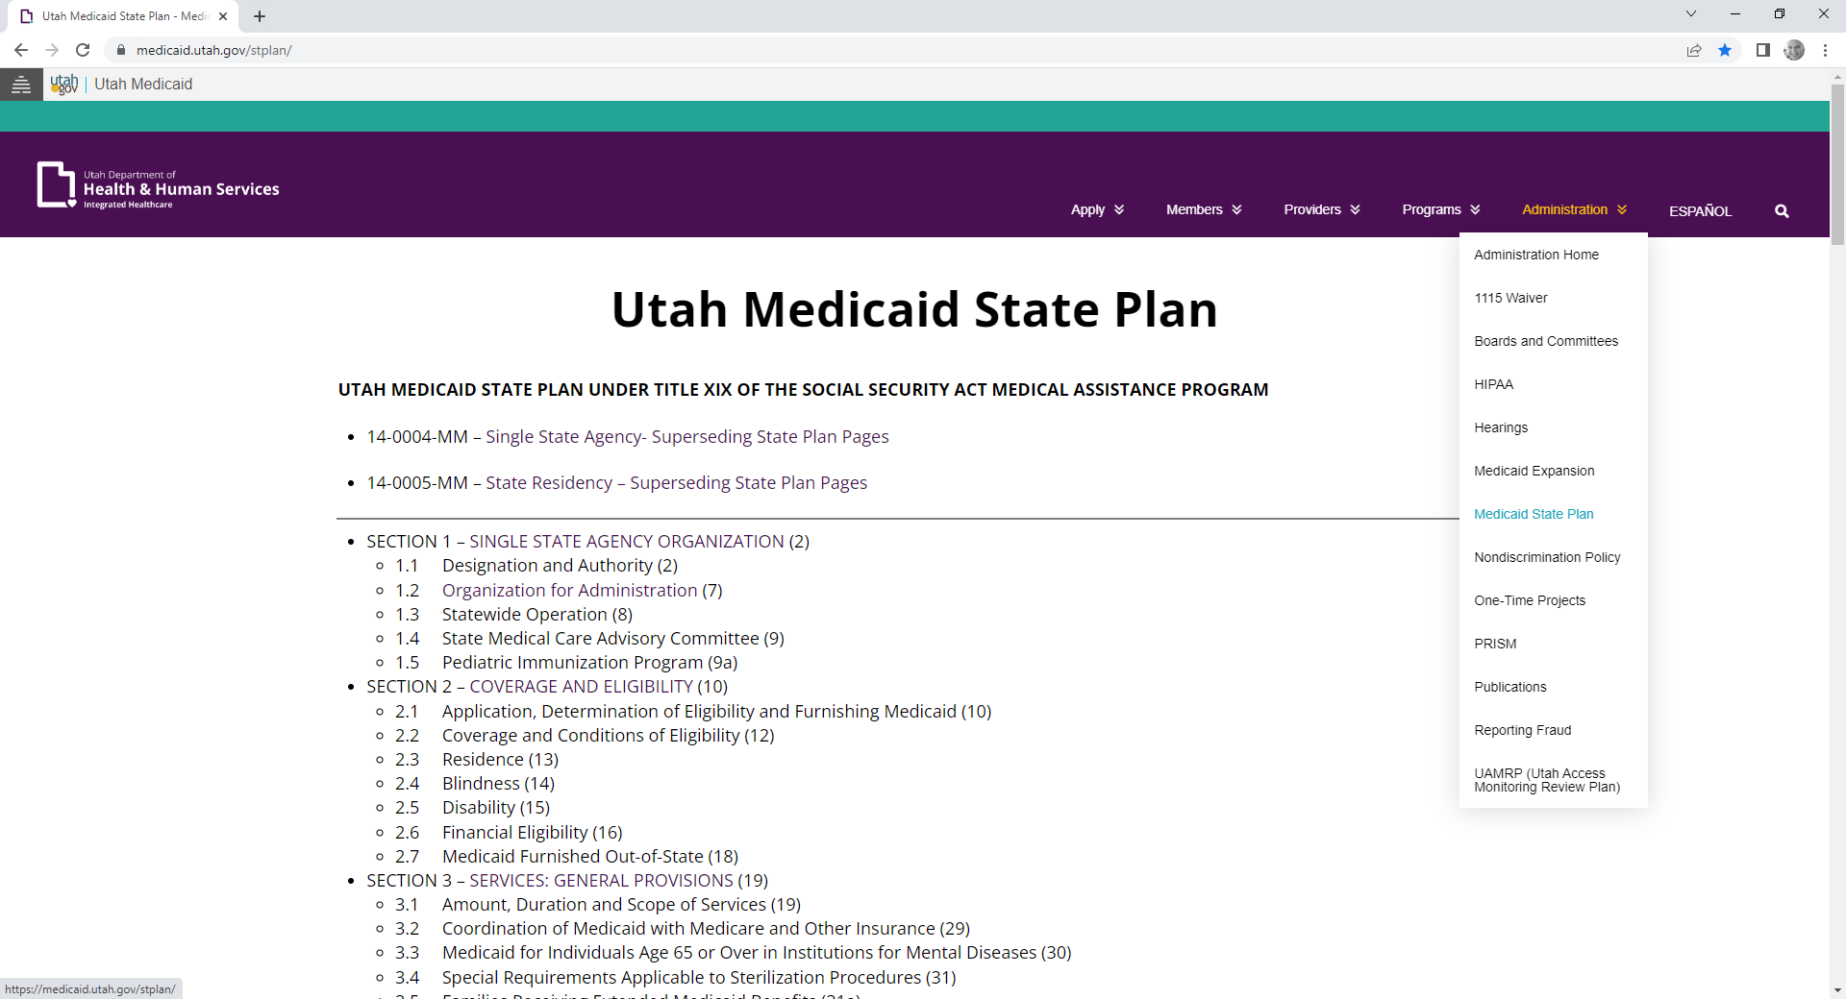
https://medicaid.utah.gov/> Administration & Publications
Where to Find the State Plan and Manuals

Slide 27
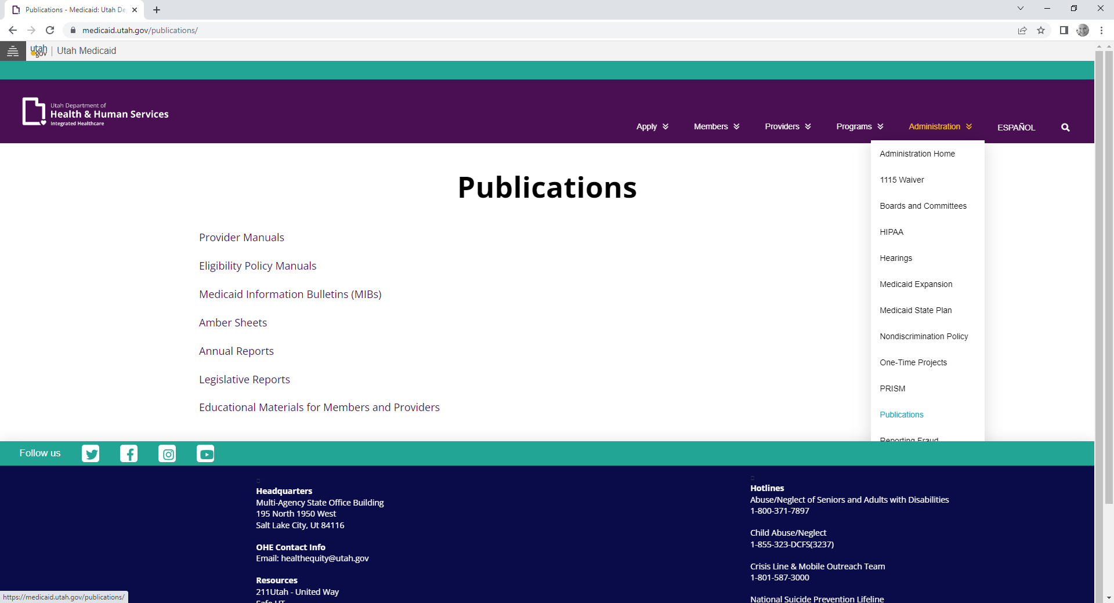
https://medicaid.utah.gov/> Administration & Publications
Where to Find the State Plan and Manuals

Slide 28
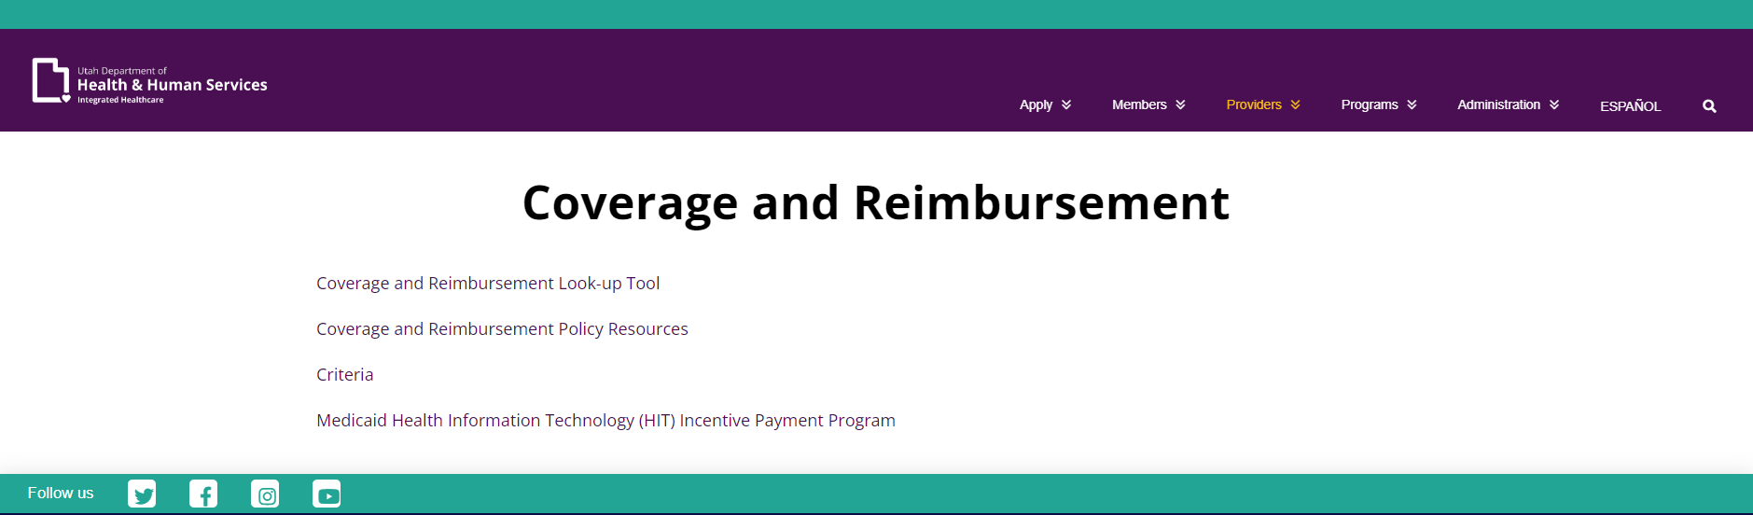
https://health.utah.gov/stplan/lookup/CoverageLookup.php
Where to Find Codes

Slide 29
Contact Information
Office of Healthcare Policy & Authorization
Department of Health and Human Services
(801) 538-6094

Slide 30
The 1115 Demonstration includes an amendment allowing for payment for substance use disorder (SUD) treatment in an Institution for Mental Disease (IMD)
Definition of an IMD: 17+ beds residential treatment, specializing in treatment of mental health disorders and SUDs
1115 SUD Amendment/Residential Treatment in an IMD

Slide 31
The 1115 Demonstration waives the IMD exclusions for licensed substance use disorder residential treatment programs
IMD exclusions:
  Substance use disorder or mental health residential treatment programs with 17+ beds
  Medicaid members ages 22 through 64 in an IMD not eligible for Medicaid
All Medicaid members 12 years of age or older, including TAM members, are eligible for treatment in licensed substance use disorder residential treatment programs with 17+ beds
Member must have a substance use disorder diagnosis to qualify for treatment in a licensed substance use disorder residential treatment program with 17+ beds
SUD Residential Treatment

Slide 32
Substance use disorder residential treatment covered under the 1115 Demonstration means:
  Face-to-face services
  Provided in licensed substance use disorder residential treatment program with 17 or more beds
  Services are a combination of medically necessary rehabilitative services outlined in the Utah Medicaid Provider Manual for Rehabilitative Mental Health and Substance Use Disorder Services and the Utah Medicaid Provider Manual for Individuals with Serious Mental Illness
  Services provided in accordance with an assessment and treatment plan
SUD Residential Treatment

Slide 33
Reporting
  Licensed substance use disorder residential treatment programs with 17+ beds report services under procedure code H0018 – short-term residential without room and board, per diem (alcohol and/or drug services)
  This is a per diem code
  Refer to the Utah Medicaid Provider Manual for Rehabilitative Mental Health and Substance Use Disorder Services for complete information on this service and the services that comprise the per diem rate
SUD Residential Treatment

Slide 34
Refer to the Utah Medicaid Provider Manual for Rehabilitative Mental Health and Substance Use Disorder Services for complete information on:
  Prior authorization requirements
  Limits on the number of days that may be approved
  Documentation requirements
SUD Residential Treatment Limits

Slide 35
Medicaid also covers licensed substance use disorder residential treatment programs with 16 or fewer beds:
  Procedure code H0018 does not apply to these programs
  These residential treatment programs use H2036
  Refer to the Utah Medicaid Provider Manual for Rehabilitative Mental Health and Substance Use Disorder Services for complete information on this service and the services that comprise this per diem rate
SUD Residential Treatment

Slide 36
Contact Information
Karen Ford
Department of Health and Human Services
kford@utah.gov / (801) 538-6637

Slide 37
If you are not a Medicaid enrolled provider, you must enroll with Utah Medicaid
An application can be started by visiting the Medicaid website: medicaid.utah.gov
  Click on the tab titled ‘Health Care Providers’
  Click on the first link titled ‘Become a Medicaid Provider’
A Utah ID will be required to start a new application
  To obtain a Utah ID visit login.utah.gov
For questions regarding the provider application process contact Provider Enrollment at 1-800-662-9651, option #3, #4
New Provider Enrollment Application Process

Slide 38
A provider has three ways to verify member eligibility:
  AccessNow:
    Dial the Medicaid information line:
  801-538-6155 or 1-800-662-9651 and select option #1
    You must have your NPI, member’s ID number or SSN, and date of birth
  Eligibility Look Up Tool
    https://medicaid.utah.gov/eligibility-lookup-tool
  Contact Customer Service during regular business hours
  (Mon-Fri 8:00 am- 5 pm, except Thurs 11:00 am-5:00 pm)
      1-800-662-9651, option #3, #3
How to Verify Eligibility

Slide 39
Providers must submit their claim via paper or electronic submission using the appropriate claim form
UHIN provides software necessary to submit claims electronically
  Providers may access this feature by calling UHIN at (801) 466-7705
If you have questions, please call Medicaid Information:
  Salt Lake City area: 801-538-6155
  Toll-free: 1-800-662-9651
Federal regulations require that a claim must be submitted to Medicaid within 365 days from the date of service
Medicaid Billing

Slide 40
Contact Information
Utah Medicaid Customer Service Hotline
(800) 662-9651, option #3, #3
(801) 538-6155

Slide 41

Questions?

